Slide 1
Diamonds Consulting Proposal
Last Updated: Jan 2, 2023

Slide 2
Outline
Overview
The Problem
Sources
Objective
Summary
Supporting Visuals
Questions

Slide 3
Overview
Diamonds are a lady’s best friend, or so they say, with so many aspects that come into play finding the right diamond is never easy. Today my job is showcase through visuals and understanding that picking the right diamond isn’t about any specific area but a combination of them all.

Slide 4
Understanding the problem
Quality
Price
Weight
A quality diamond is everyone’s dream, picking the right balance of each piece is every possible while still obtaining a very high quality diamond.
No matter what type of diamond you’re getting, most people equate the price with the quality. There are makers that can provide high quality whilst keeping the price low.
The weight of a diamond can be a key piece in decision making. Wearing a heavier “rock” can cause decisions to go another way but you can still get the best “bang for your buck.”

Slide 5
Project objective:
Analyze the data and find how diamonds can differ to help the marketing team build a digital marketing strategy to find the sweet spot in making diamonds to sell.

Slide 6
Summary
I believe that overpriced diamonds could be a thing of the past and jewelry stores making sure their diamonds meet all the expected criteria in different elements when looking at diamonds will be essential. Finding that special plethora of a diamond is highly attainable and taking the time thoroughly check each piece will have a bigger outcome.
Simply said, having high priced diamonds no longer means you have the best quality.

Slide 7
Supporting Visuals

Slide 8
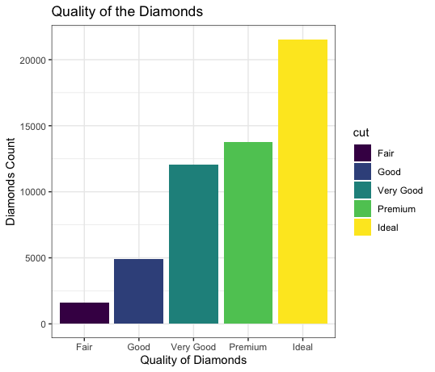
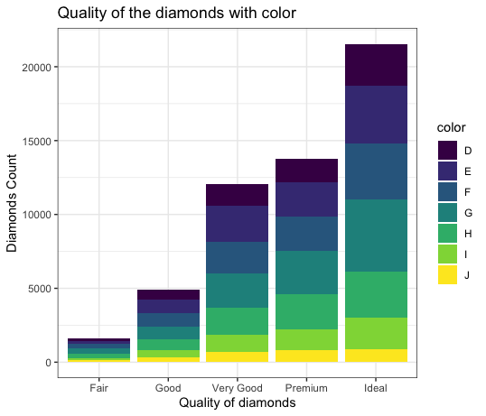

Slide 9
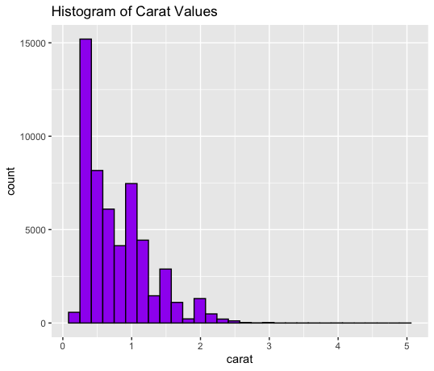
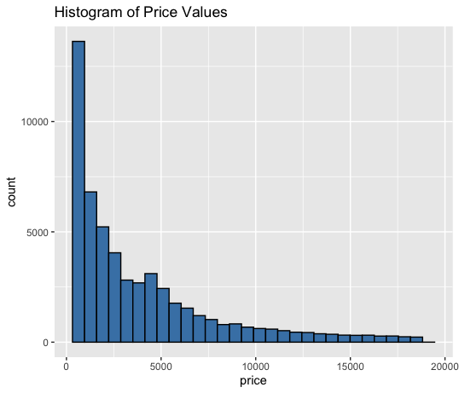

Slide 10
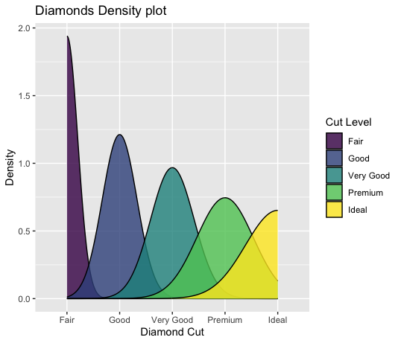

Slide 11
Questions?

